Slide 1
Chapter 4: Switched Networks
CCNA Routing and Switching
Routing and Switching Essentials v6.0
Notes:
Cisco Networking Academy Program
Routing and Switching Essentials v6.0
Chapter 4: Switched Networks

Slide 2
Chapter 4 - Sections & Objectives
4.1 LAN Design
Explain how switched networks support small to medium-sized businesses.
Explain how data, voice, and video are converged in a switched network.
Describe a switched network in a small to medium-sized business.
4.2 The Switched Environment
Explain how Layer 2 switches forward data in a small to medium-sized LAN.
Explain how frames are forwarded in a switched network.
Compare a collision domain to a broadcast domain.
Notes:
2
Cisco Networking Academy Program
Routing and Switching Essentials v6.0
Chapter 4: Switched Networks

Slide 3
4.1 LAN Design
Notes:
4 – Switched Networks
4.1 – LAN Design

Slide 4

Converged Networks Growing Complexity of Networks
Next-generation networks need to be secure, reliable, and highly available.
They must support a globalized workforce.
They must be able to integrate legacy devices.
Notes:
4.1 – LAN Design
4.1.1 – Converged Networks
4.1.1.1 – Growing Complexity of Networks

Slide 5
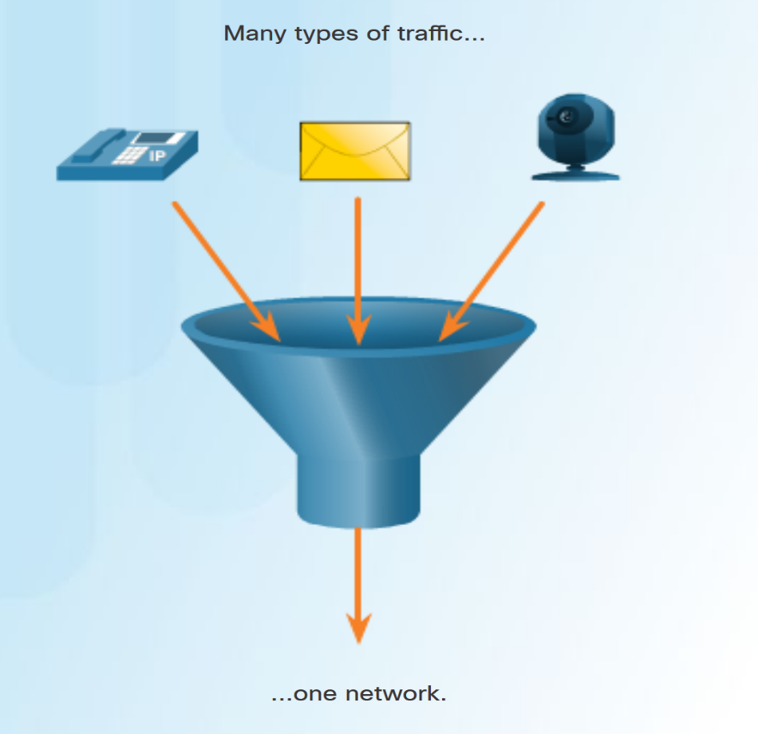
Converged Networks Elements of a Converged Network
Converged network solutions integrate voice systems, IP phones, voice gateways, video support, and video conferencing.
Primary benefit of the converged network - just one physical network to install and manage.
Notes:
4.1 – LAN Design
4.1.1 – Converged Networks
4.1.1.2 – Elements of a Converged Network

Slide 6
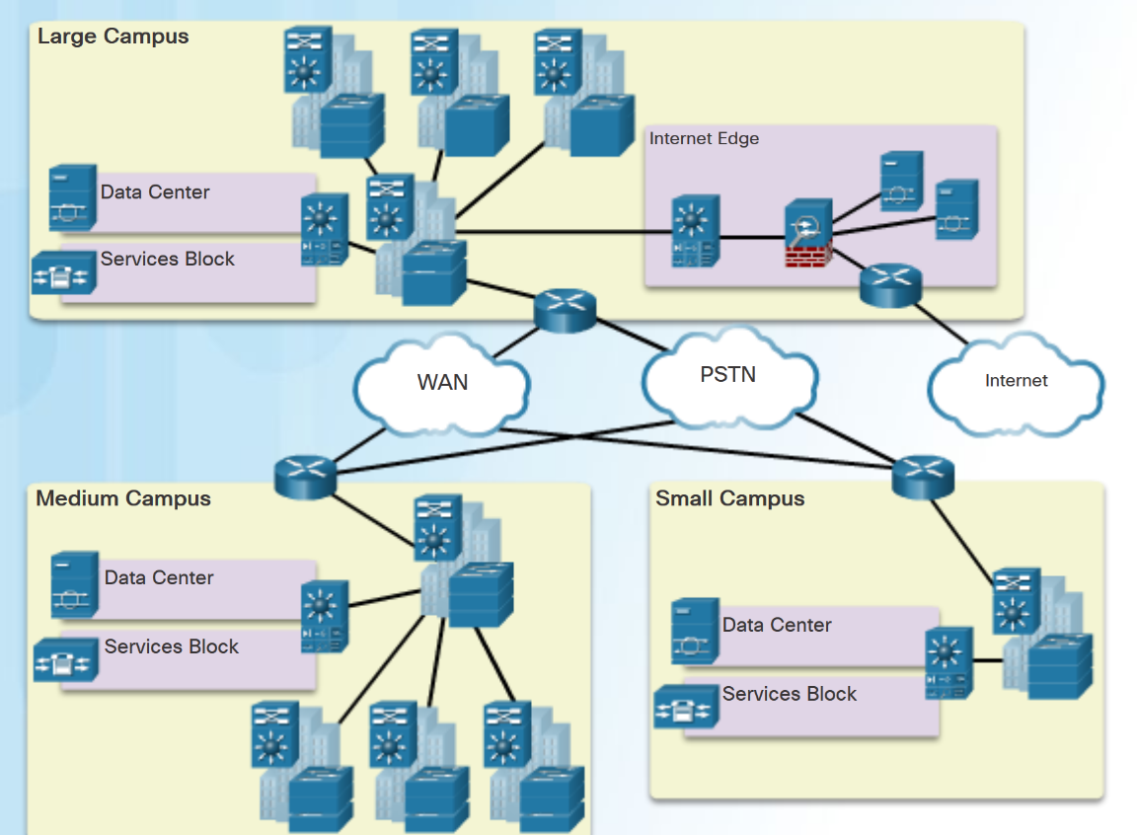
Converged Networks Cisco Borderless Networks
The Cisco Borderless Network has the following features:
Allows organizations to connect anyone, anywhere, anytime, on any device; securely, reliably, and seamlessly.
Provides the framework to unify wired and wireless access, including policy, access control, and performance management across many different device types.
Provides network services, and user and endpoint services that are all managed by an integrated management solution.
Notes:
4.1 – LAN Design
4.1.1 – Converged Networks
4.1.1.3 – Cisco Borderless Networks

Slide 7
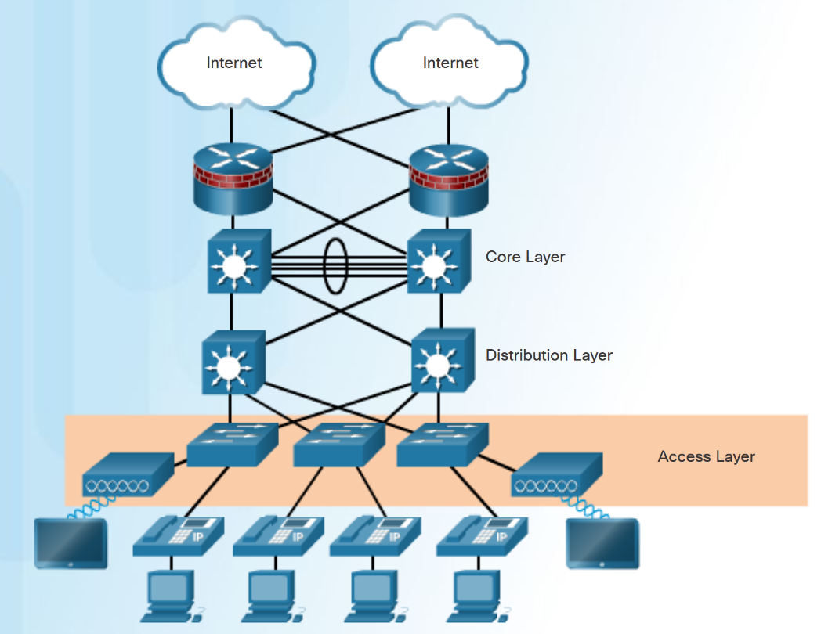
Converged Networks Hierarchy in the Borderless Switched Network
Borderless switched network design guidelines are based on the following principles:
Hierarchical - Facilitates understanding the role of each device at every tier.
Modularity - Allows seamless network expansion and integrated services.
Resiliency – Provides an always available network.
Flexibility - Allows intelligent traffic load sharing.
The three tiers of the hierarchical model are Access, Distribution and Core layers.
Notes:
4.1 – LAN Design
4.1.1 – Converged Networks
4.1.1.4 – Hierarchy in the Borderless Switched Network

Slide 8
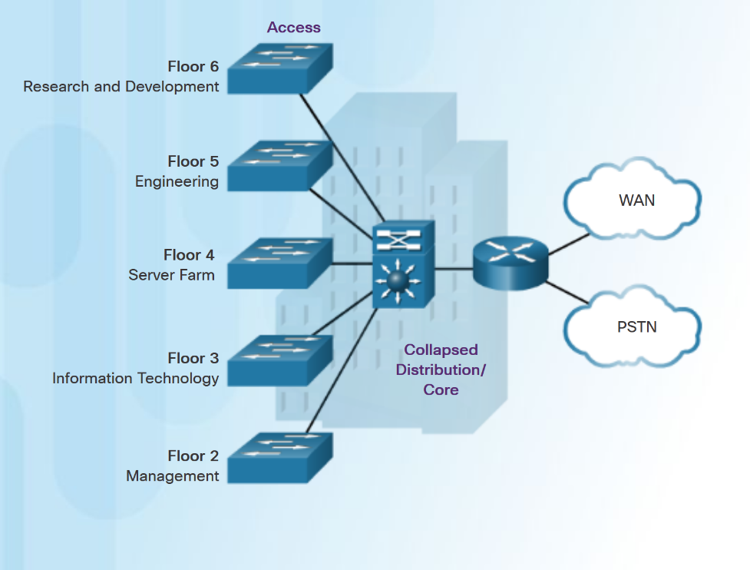
Converged Networks Access, Distribution, and Core Layers
Access Layer – provides network access to the user.
Distribution Layer - interfaces between the access layer and the core layer. Provides functions such as:
aggregating Layer 2 broadcast domains and Layer 3 routing boundaries.
providing intelligent switching, routing, and network access policy functions to access the rest of the network.
Core Layer - is the network backbone. It provides fault isolation and high-speed backbone connectivity.
Smaller networks that do not need a separate distribution and core layer often use a two-tier campus or collapsed core network design.
Notes:
4.1 – LAN Design
4.1.1 – Converged Networks
4.1.1.5 – Access, Distribution, and Core Layers

Slide 9
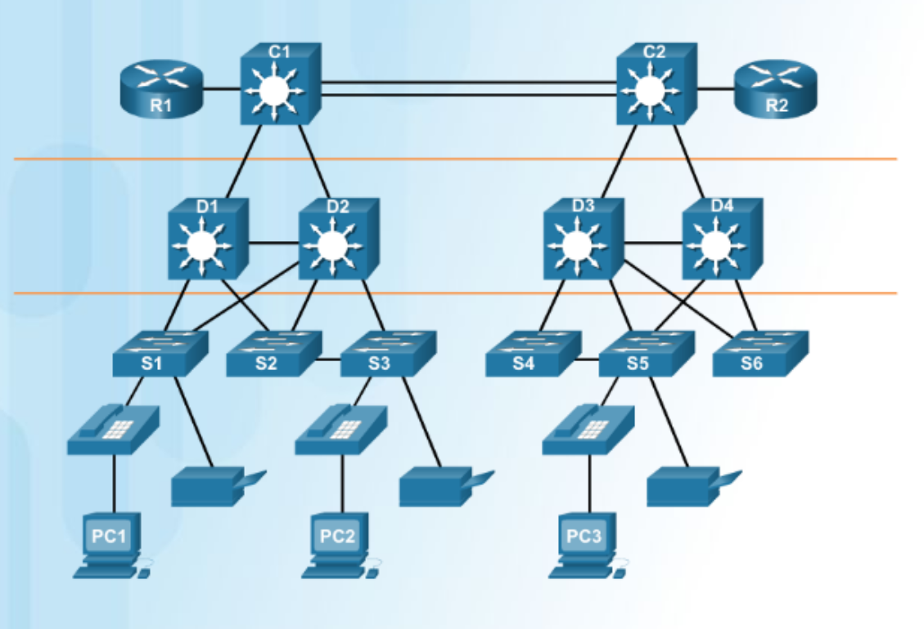
Switched Networks Role of Switched Networks
A hierarchical switched LAN allows more flexibility, traffic management, and additional features:
Quality of service
Additional security
Support for wireless networking and connectivity
Support for new technologies.
Notes:
4.1 – LAN Design
4.1.2 – Switched Networks
4.1.2.1 – Role of Switched Networks

Slide 10
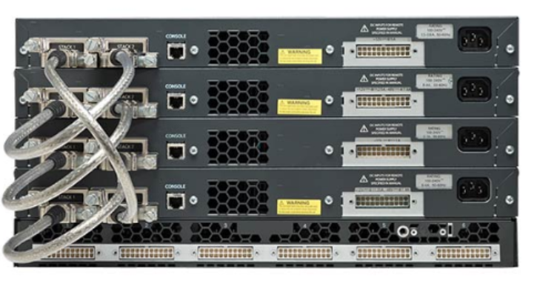
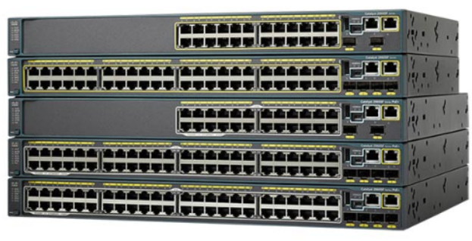
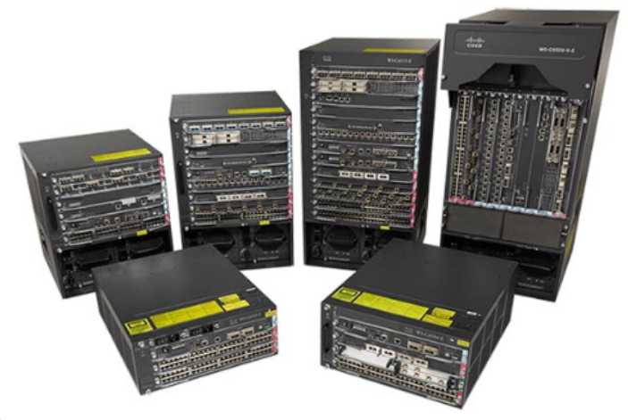
Switched Networks Form Factors
Stackable Configuration
Fixed Configuration
Considerations when selecting switches:
Cost
Port Density
Power
Reliability
Port Speed
Frame buffers
Scalability
Modular Configuration
Notes:
4.1 – LAN Design
4.1.2 – Switched Networks
4.1.2.2 – Form Factors

Slide 11
4.2 The Switched Environment
Notes:
4 – Switched Networks
4.2 – The Switched Environment

Slide 12
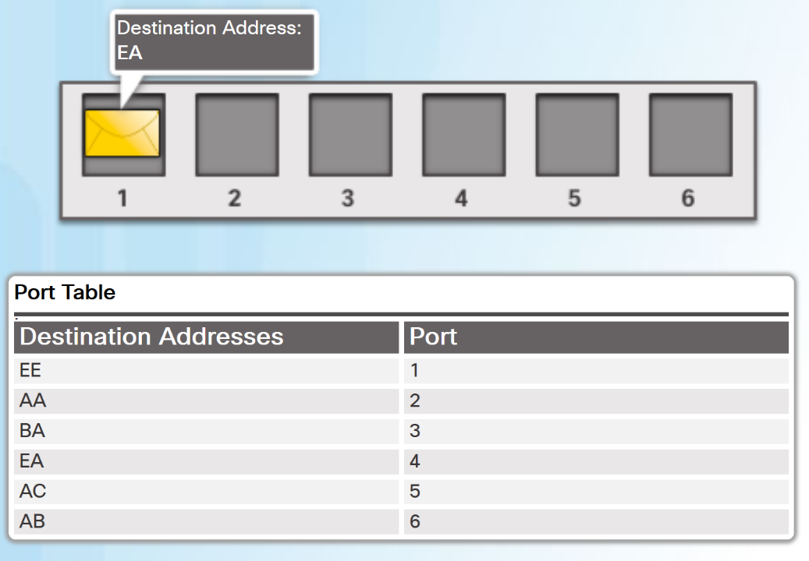
Frame Forwarding Switching as a General Concept in Networking and Telecommunications
A LAN switch makes decisions based on two criteria:
Ingress port - where a frame enters the device
Destination address
A LAN switch maintains a table that it uses to determine how to forward traffic.
In the diagram, If a message enters switch port 1 with a destination address of EA, then the switch forwards the traffic out port 4.
Layer 2 Ethernet switches forward frames based on the destination MAC address.
Notes:
4.2 – The Switched Environment
4.2.1 – Frame Forwarding
4.2.1.1 – Switching as a General Concept in Networking and Telecommunications

Slide 13
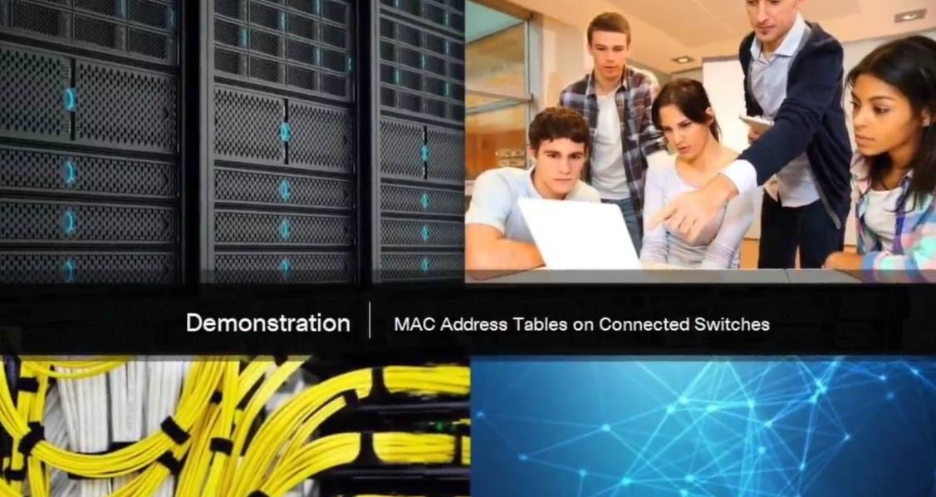
Frame Forwarding Video Demonstration - MAC Address Tables on Connected Switches
The video explains how a switch builds its MAC address table by recording the MAC address of each device connected to each of its ports.
Notes:
4.2 – The Switched Environment
4.2.1 – Frame Forwarding
4.2.1.2 – Video Demonstration - MAC Address Tables on Connected Switches

Slide 14
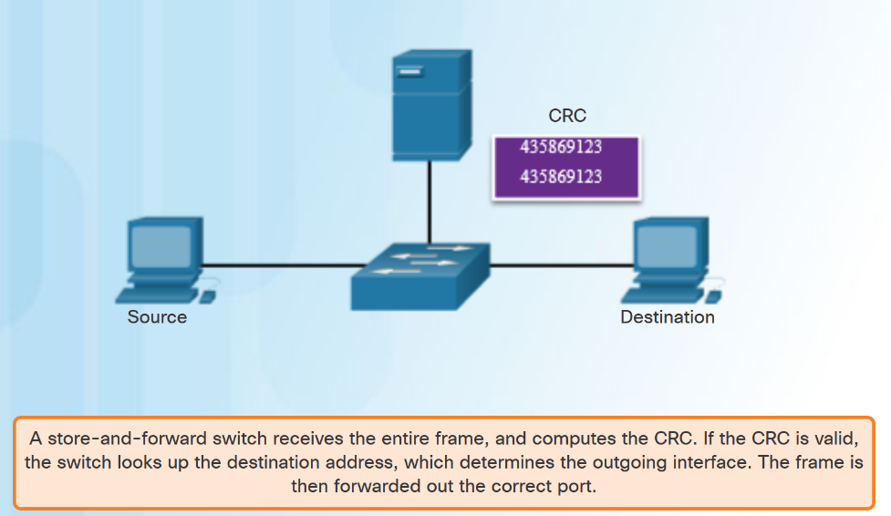
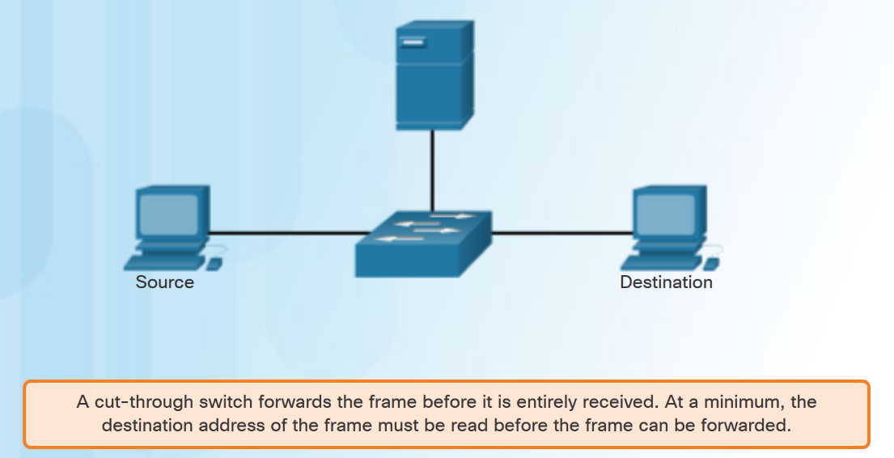
Frame Forwarding Switch Forwarding Methods
Notes:
4.2 – The Switched Environment
4.2.1 – Frame Forwarding
4.2.1.3 – Switch Forwarding Methods

Slide 15
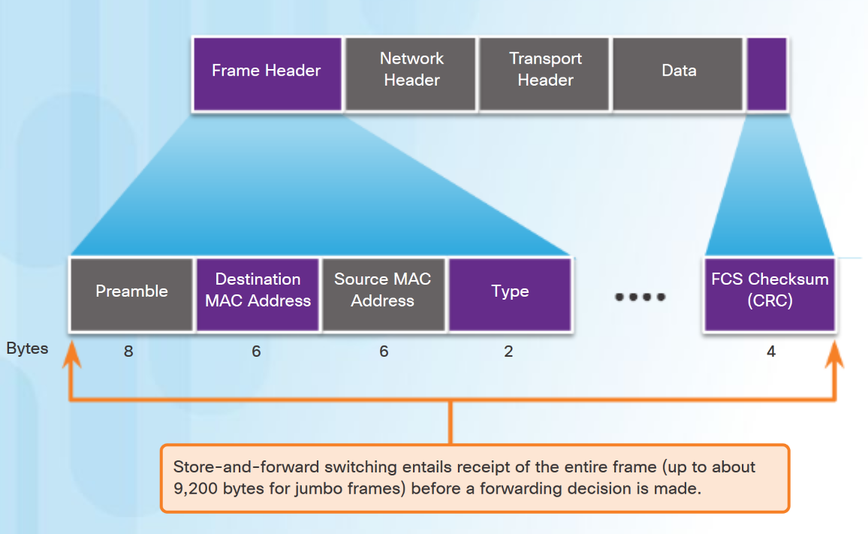
Frame Forwarding Store-and-Forward Switching
Features of Store-and-Forward Switching:
Error Checking– After receiving the entire frame, the switch compares the frame-check-sequence (FCS) value in the last field against its own FCS calculations. Only error-free frames are forwarded
Automatic Buffering– ingress port buffering provides the flexibility to support any mix of Ethernet speeds.
Store-and-Forward is Cisco’s primary LAN switching method.
Notes:
4.2 – The Switched Environment
4.2.1 – Frame Forwarding
4.2.1.4 – Store-and-Forward Switching

Slide 16
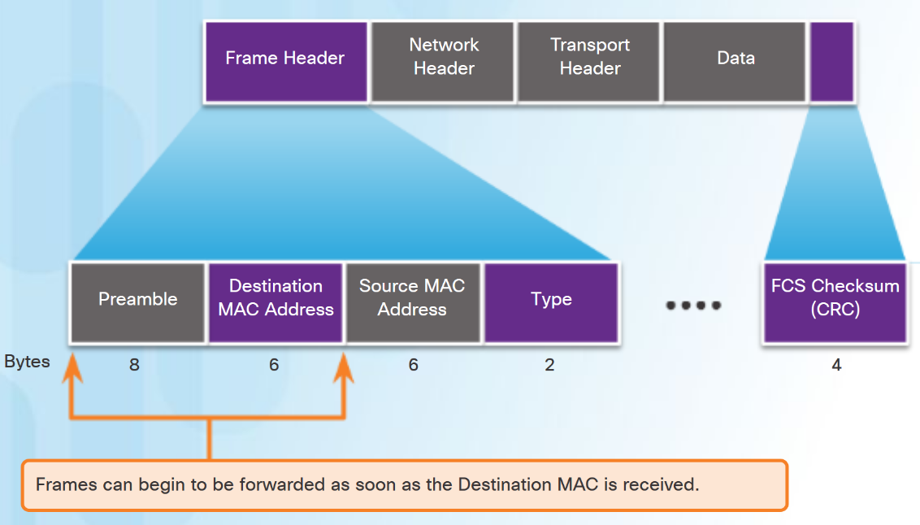
Frame Forwarding Cut-Through Switching
Rapid Frame Forwarding - The switch can make a forwarding decision as soon as it has looked up the destination MAC address.
Frames with errors are forwarded.
Fragment Free - modified form of cut-through switching. The switch waits for the collision window (64 bytes) to pass before forwarding the frame.
Provides better error checking than cut-through, with practically no increase in latency.
Notes:
4.2 – The Switched Environment
4.2.1 – Frame Forwarding
4.2.1.5 – Cut-Through Switching

Slide 17
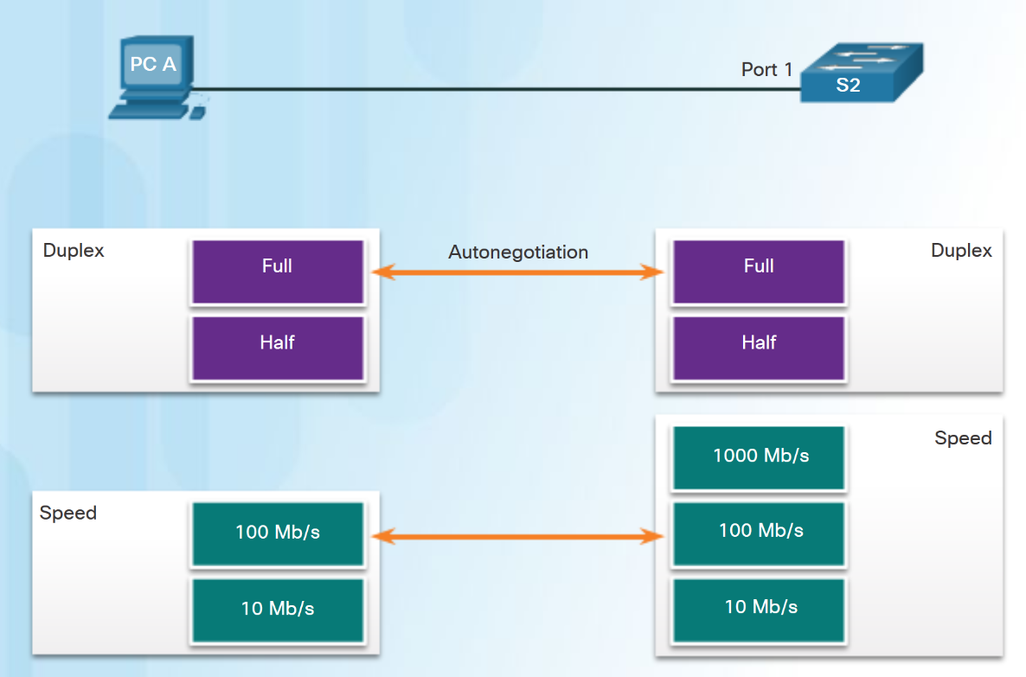
Switching Domains Collision Domains
In hub-based Ethernet segments, network devices compete for the medium, therefore collisions will occur.
Ethernet switch ports operating in full duplex eliminate collisions.
Ethernet switch ports will autonegotiate full-duplex if connected to full-duplex device.
If connected to a half-duplex device then the switch port will operate in half duplex and be part of a collision domain.
Notes:
4.2 – The Switched Environment
4.2.2 – Switching Domains
4.2.2.1 – Collision Domains

Slide 18
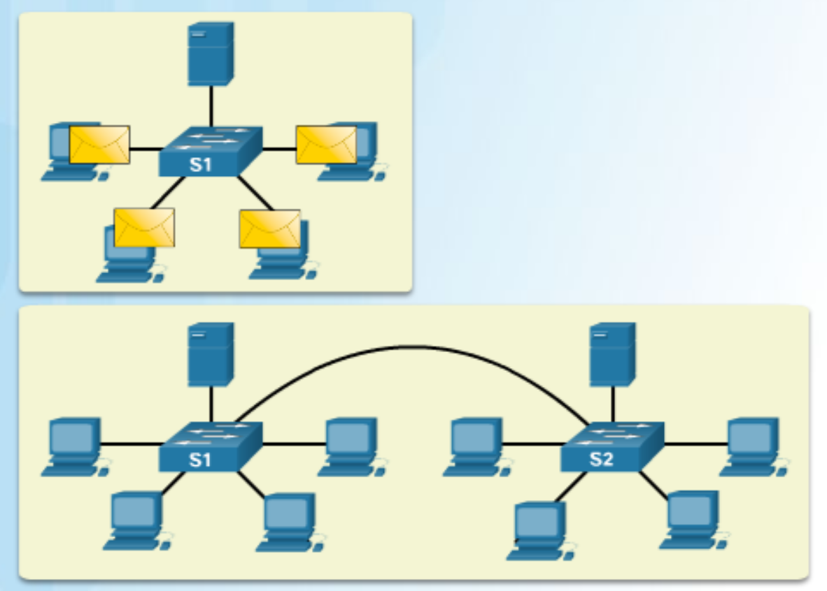
Switching Domains Broadcast Domains
One switch or multiple interconnected switches form a single broadcast domain.
When a switch receives a broadcast frame, it forwards the frame out each of its ports, except the ingress port where the broadcast frame was received.
When two switches or more switches are connected together, the broadcast domain is increased because the broadcast is propagated from switch to switch.
Too many broadcasts can cause network congestion.
Notes:
4.2 – The Switched Environment
4.2.2 – Switching Domains
4.2.2.2 – Broadcast Domains

Slide 19
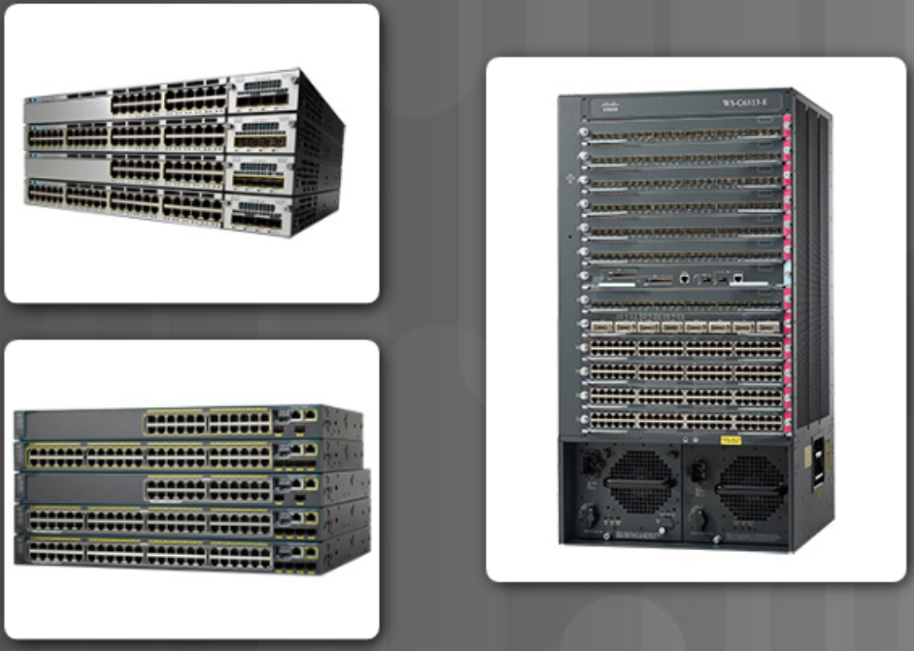
Switching Domains Alleviating Network Congestion
The following characteristics of switches help alleviate congestion:
Establishing full-duplex links, therefore eliminating collisions.
High port density
Large frame buffers
Port speed
Fast internal switching
Low per-port cost
Notes:
4.2 – The Switched Environment
4.2.2 – Switching Domains
4.2.2.3 – Alleviating Network Congestion

Slide 20
4.3 Chapter Summary
Notes:
4 – Switched Networks
4.3– Summary

Slide 21
Conclusion Chapter 4: Switched Networks
Explain how switched networks support small to medium-sized businesses.
Explain how Layer 2 switches forward data in a small to medium-sized LAN.
Notes:
4.3 – Summary
4.3.1 – Conclusion
4.3.1.3 – Chapter 4: Switched Networks

Slide 22
Switched Networks New Terms and Commands
form factors
Fixed configuration switches
Modular configuration switches
line cards
Stackable configuration switches
ingress
egress
MAC address table
content addressable memory (CAM) table
Ethernet bridges
application-specific-integrated circuits (ASICs)
store-and-forward switching
cut-through switching
cyclic redundancy check (CRC)
egress port
network
Call control
Automated attendant
PC softphone
Cisco Borderless Network
collapsed core layer model
three layer hierarchical model
access layer
distribution layer
core layer
Port Density
Frame Buffers
Scalability
rack units
Notes:
New Terms and Commands

Slide 23
Switched Networks New Terms and Commands (Cont.)
frame-check-sequence (FCS)
buffer
rapid frame forwarding
fragment free
Fragment free switching
collision domains
broadcast domains
full duplex
autonegotiate
half duplex
High port density
Notes:
New Terms and Commands

